Slide 1

Employee Face Detection & Recognition System
Shri Shankaracharya Group of Institution
Project by:
Riya Jaiswal 301403318007 7th ‘A’
Parul Verma 301403318024 7th ‘A’
Nikhil Shiladitiya 301403318036 7th ‘A’

Slide 2
Introduction
Face Detection and Recognition System (FDRS) is a physical characteristics recognition technology, using the inherent physiological features of humans for ID recognition. The technology does not need to be carried about and will not be lost, so it is convenient and safe for use.
Face recognition today is a big part of our lives like we have that system in our mobile phones and there are many places where this system is installed and coming in a huge use and gives a great advantage also.

Slide 3
There are two general applications of FDRS, one is called identification and another one is called verification. Face identification : means given a face image, we want the system to tell who he / she is or the most probable identification. Face verification : means given a face image and a guess of the identification, we want the system to tell true or false about the guess.

Slide 4
Major Objectives
Faces Detection : Scanning of face of employee is done during this process.
Save face To Database : Save information about the employee in the database.
Face Recognition : Recognises and matches the face with the database
Provides accurate information about them : Provide information about the check in and check out of the employee.

Slide 5


Slide 6
Scope
A method is to be composed of three parts:
Face detection : It is an artificial intelligence (AI) based computer technology used to find and identify human faces in digital images. Face detection technology can be applied to various fields, including security, biometrics, law enforcement, entertainment and personal safety, to provide surveillance and tracking of people in real time.
Face Extraction : An extraction is the process of clearing a clogged or compacted pore by manual or mechanical means. Extractions are often performed as part of a facial.

Slide 7
Face Recognition : Facial recognition is a way of identifying or confirming an individual’s identity using their face. Facial recognition systems can be used to identify people in photos, videos, or in real-time. Facial recognition is a category of biometric security. To proposed such a method that illustrates the robustness against the appearance, variations of expression, lightening and presence/absence of accessories. Performance of proposed method will be tested upon the standard face database namely YALE database. Extensive experiments are yet to be apply to demonstrate the effectiveness of method.

Slide 8
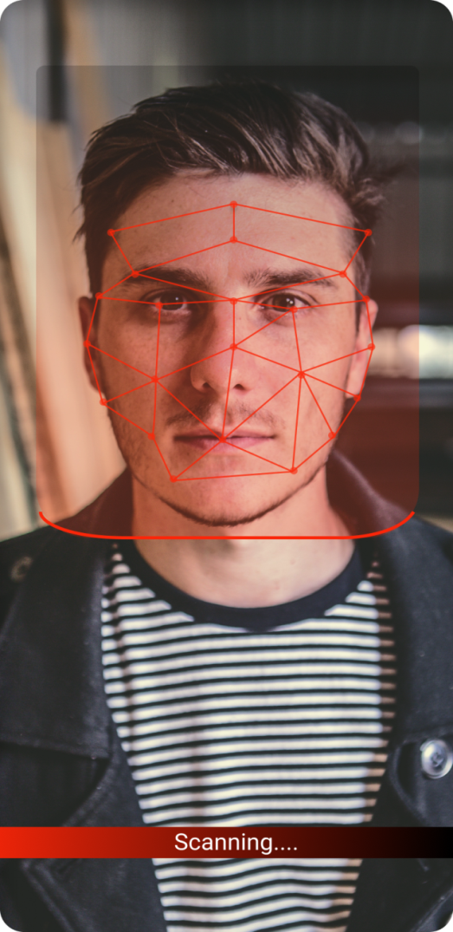
Project Specification
TOOLS :-
FIGMA (FOR UI)
DBMS
AI & ML
HARDWARE SPECIFICATION :-
Processor : ALL PROCESSOR
RAM : 4 GB or MORE
HARD DISK : 5 GB free Space
SOFTWARE REQUIRMENT :-
Operating System : Windows 7/8/10
IDE Software : Visual Studio

Slide 9
Working
It’s a face recognition system where employees have to scan themselves and answer the further questions regarding to the purpose of there visit. And the system will record all the details of employees like your purpose of visiting, at what time they checked-in or checked-out.
It provide safety and security of data and employees during pandemic.

Slide 10








User Interface

Slide 11
Thankyou

